Slide 1
Optimized architecture
Notes:
Information in this document, including URL and other Internet Web site references, is subject to change without notice. Unless otherwise noted, the example companies, organizations, products, domain names, e-mail addresses, logos, people, places, and events depicted herein are fictitious, and no association with any real company, organization, product, domain name, e-mail address, logo, person, place or event is intended or should be inferred. Complying with all applicable copyright laws is the responsibility of the user. Without limiting the rights under copyright, no part of this document may be reproduced, stored in or introduced into a retrieval system, or transmitted in any form or by any means (electronic, mechanical, photocopying, recording, or otherwise), or for any purpose, without the express written permission of Microsoft Corporation.
Microsoft may have patents, patent applications, trademarks, copyrights, or other intellectual property rights covering subject matter in this document. Except as expressly provided in any written license agreement from Microsoft, the furnishing of this document does not give you any license to these patents, trademarks, copyrights, or other intellectual property.
The names of manufacturers, products, or URLs are provided for informational purposes only and Microsoft makes no representations and warranties, either expressed, implied, or statutory, regarding these manufacturers or the use of the products with any Microsoft technologies. The inclusion of a manufacturer or product does not imply endorsement of Microsoft of the manufacturer or product. Links may be provided to third party sites. Such sites are not under the control of Microsoft and Microsoft is not responsible for the contents of any linked site or any link contained in a linked site, or any changes or updates to such sites. Microsoft is not responsible for webcasting or any other form of transmission received from any linked site. Microsoft is providing these links to you only as a convenience, and the inclusion of any link does not imply endorsement of Microsoft of the site or the products contained therein.
© 2018 Microsoft Corporation. All rights reserved.
Microsoft and the trademarks listed at https://www.microsoft.com/en-us/legal/intellectualproperty/Trademarks/Usage/General.aspx are trademarks of the Microsoft group of companies. All other trademarks are property of their respective owners.

Slide 2
Abstract and learning objectives
In this whiteboard design session, you will review how to size and optimize a migrated workload to Azure Infrastructure as a service (IaaS). From there, you will consider the cost and benefit of optimizing the solution using Azure Platform as a service (PaaS) services and then design and price the optimized solution.
At the end of this whiteboard design session, you will be better able to design and plan for optimizing Azure IaaS and PaaS deployments, price solutions using the Azure calculator, and setup multi-region solutions.

Slide 3
Step 1: Review the customer case study
Outcome
Analyze your customer needs.
Timeframe
15 minutes

Slide 4
Customer situation
Contoso Financial Inc. is one of the fastest growing financial organizations in the United States. With its corporate headquarters in Chicago, IL the company has grown to over 1,000 employees. The vast majority of employees work from one of the regional offices strategically located in all of the major United States cities; however, many of the employees work remotely either on a daily basis or even after hours.
Contoso has recently completed a migration to shift the majority of its enterprise data center footprint to the cloud. “The cloud is the future, and as such, it is essential for us to proactively adopt the cloud before our competitors in an effort to remain innovative and as competitive as possible,” says Emma Lowton, Chief Technology Officer. “Unfortunately, due to our limited expertise in cloud computing, I have grown concerned that our Azure spending is much higher than it should be.”

Slide 5
Customer situation (continued)
The migration process performed by Contoso used a “Lift and Shift” method to move their existing workloads into Microsoft Azure. Their current Azure usage is very dependent on the Infrastructure as a Service (IaaS) services in addition to the adoption of Azure Active Directory (AD) and Office 365. So far, they have not utilized the Platform as a Service (PaaS) services very much with the exception of Azure Storage and Azure Service Bus Queue which was used to replace MSMQ.
Last year, Contoso completed the acquisition of the European based Lucerne Ltd. With the acquisition complete, the deadline has been set to begin migrating all Lucerne employees over to using the Contoso systems within 18 months. The Chief Executive Office, Jay Calvin’s biggest concern with the existing architecture is, “With concerns about spending too much, I am very concerned we will not be able to stay competitive as we onboard the Lucerne employees over to use Contoso systems.”

Slide 6
Customer situation (continued)
The existing architecture is currently bloated since the on-premises architecture was just mirrored in the cloud. This fact grants much validity to the concerns of spending much more than necessary. The existing architecture within Azure needs to be modified to match more closely with the workload demand and utilize some of the cloud features of Azure that allow for greater cost savings. In addition to reducing cost, the architecture also needs to be optimized to be able to handle Contoso’s future growth even after Lucerne employees have been onboarded.
The primary concern of Percy Bowman, the Director of IT Operations, is that “the current architecture is much too difficult to maintain over time, especially as the company continues to grow and expand into Europe.” As the company continues to grow, the system needs to be able to scale more easily, as adding more VMs over time will eventually lead to prohibitive costs.

Slide 7
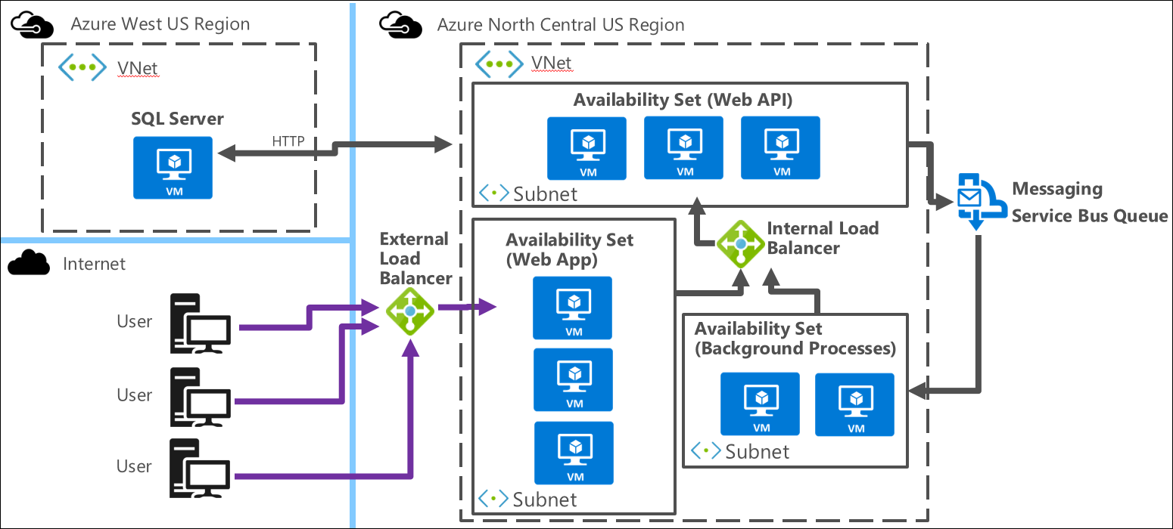
Existing architecture

Slide 8
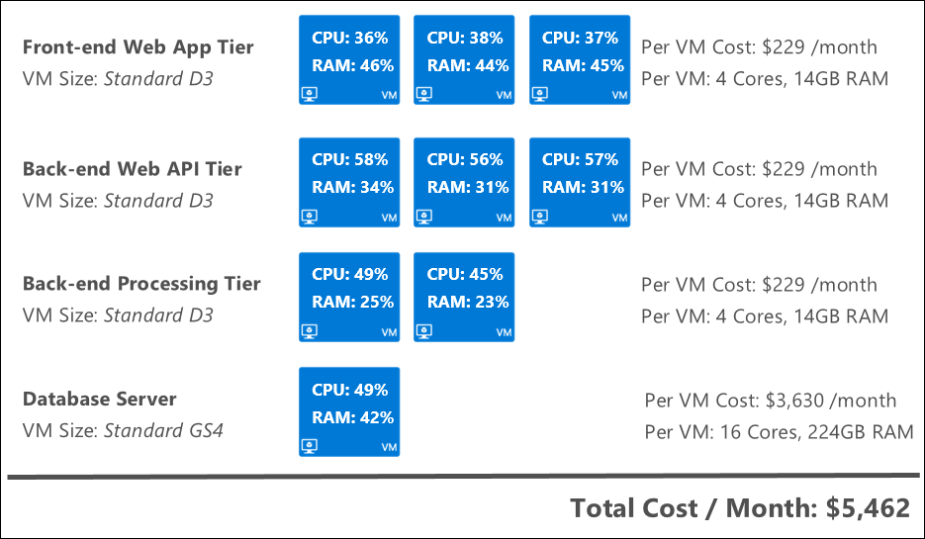
Existing architecture – VM sizes and utilization
The Contoso IT Operations team decided to standardize on the “Standard D3” Virtual Machine (VM) instance size (4 Cores, 14GB RAM) for the front-end and back-end tiers using Standard storage. The SQL Server database server VM needs more resources so it is configured to use the “Standard GS4” VM instance size (16 Cores, 224GB RAM).
CPU = Central Processing Unit
1 Core = 1 CPU
Notes:
LINKS:
https://azure.microsoft.com/en-us/pricing/details/virtual-machines/windows-previous/

Slide 9
Customer needs
Design a two-phase approach to the process of migrating Azure resources towards the goal of optimized spending.
Fix the SQL Server database hosting to be more robust, reliable, and enterprise-grade.
Automatic scaling needs to be implemented to reduce the manual process involved.
Identify the appropriate method to use for scaling out the different application tiers to meet increases in load.
Identify the appropriate VM sizes for each application tier.

Slide 10
Customer needs (continued)
Validate the appropriate Azure Regions are used for hosting and create a plan to migrate any necessary resources to a different region.
Identify the PaaS services to use and the App Service Plans and create a migration plan.
Identify a strategy to reduce server maintenance, as the system is scaled out to meet increased load.
The migration steps should not require any changes to the application code.

Slide 11
Customer objections
Reducing the overall spending on Azure is great, but how will we ensure costs remain optimized?
If we drastically change the overall architecture, will we be able to migrate it without taking it down for a week?
Our operations team is new to the cloud and Microsoft Azure. While we are comfortable using the IaaS services, we are concerned that PaaS services will be difficult to monitor and maintain when mixed with IaaS services in our overall environment.

Slide 12
Customer objections (continued)
We are concerned that the system performance for the European users will not be as good as it needs to be. In the past we have had employees work while traveling and the system was slow for them.
The VM sizes currently used appear to be more than we need, but how can we determine what the appropriate sizes should be?
We have already purchased SQL Server and other product licenses. I am worried the savings from optimizing spending using Azure PaaS services will not be significant to be worth it.

Slide 13
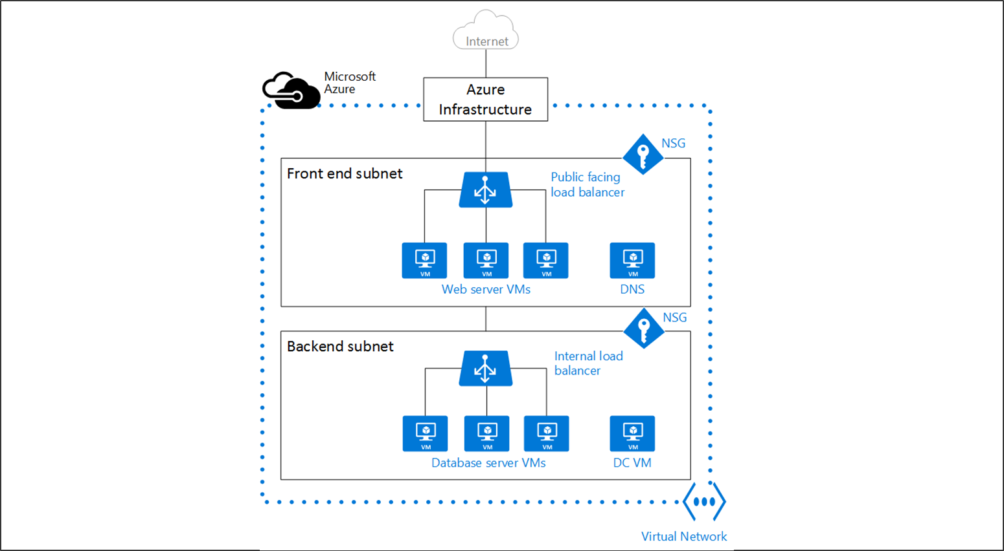
Common scenarios VNet w/ VMs and Load Balancers

Slide 14
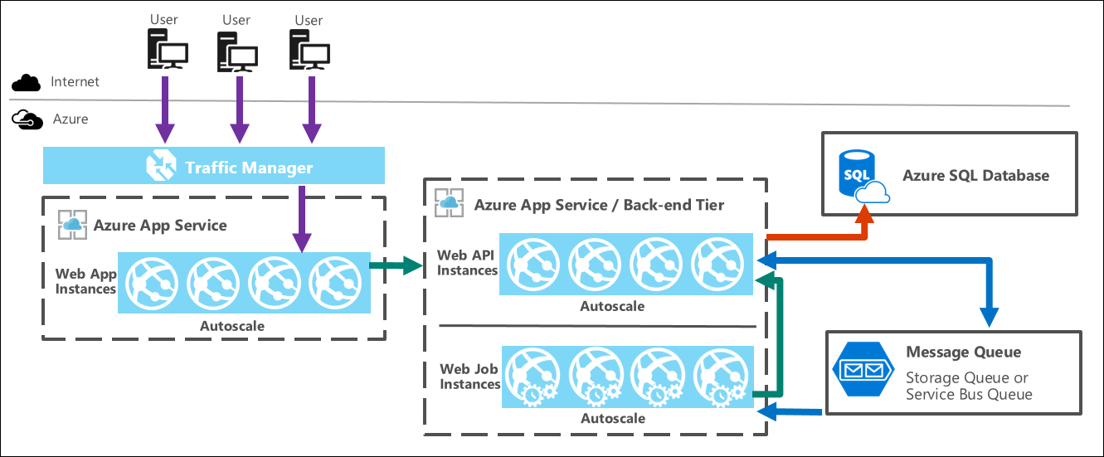
Common scenarios 3-tier Azure Web App

Slide 15
Step 2: Design the solution
Outcome
Design a solution and prepare to present the solution to the target customer audience in a 15-minute chalk-talk format.
Timeframe
60 minutes
Business needs (10 minutes) | Respond to questions outlined in your guide and list the answers on a flipchart.
Design (35 minutes) | Design a solution for as many of the stated requirements as time allows. Show the solution on a flipchart.
Prepare (15 minutes) | Identify any customer needs that are not addressed with the proposed solution. Identify the benefits of your solution. Determine how you will respond to the customer’s objections. Prepare for a 15-minute presentation to the customer.

Slide 16
Step 3: Present the solution
Outcome
Present a solution to the target customer in a 15-minute chalk-talk format.
Timeframe
30 minutes (15 minutes for each team to present and receive feedback)
Directions
Pair with another table.
One table is the Microsoft team and the other table is the customer.
The Microsoft team presents their proposed solution to the customer.
The customer asks one of the objections from the list of objections in the case study.
The Microsoft team responds to the objection.
The customer team gives feedback to the Microsoft team.

Slide 17
Wrap-up
Outcome
Identify the preferred solution for the case study.
Identify solutions designed by other teams.
Timeframe
15 minutes

Slide 18
Preferred target audience
Jay Calvin, Chief Executive Officer
Percy Bowman, Director of IT Operations

Slide 19
Preferred solution Phase 1 – overview
The Phase 1 Design remains centered around the use of Azure Infrastructure (IaaS) services to further optimize the spending of the existing architecture. The Phase 1 Design solution involves the following technologies and modifications:
Implementing VM Scale Sets for the Font-end Web App and Back-end Web API application tiers.
Resizing the VM Sizes used for each of the application tiers should be done to eliminate any over provisioning. Over provisioning wastes money by paying for resources that are not necessary.
Resize the Front-end Web App Tier VMs to the Standard F4 VM size.
Resize the Back-end Web API Tier VMs to the Standard F4 VM size.
Resize the Back-end Processing Tier VMs to the Standard F2 VM size.
Migrating the SQL Database server to the North Central US region (same region the rest of the application resides).
Migrating the SQL Database VM to Azure SQL Database using the Premium P4 pricing tier.
Configure SQL Database Active Geo-Replication for added resiliency.

Slide 20
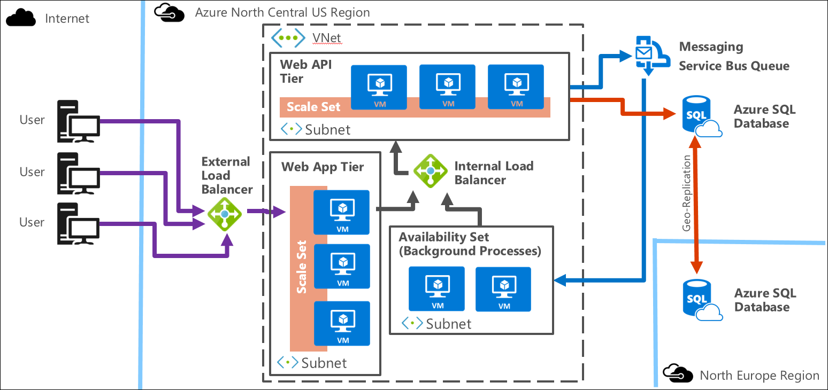
Preferred solution Phase 1 – preferred architecture

Slide 21
Preferred solution Phase 1 – migration steps
It is recommended to modify the architecture for each of the Application Tiers individually to reduce the risk of application downtime during the migration process. Here is a sample outline of recommended steps:
Migrate SQL Server database from VM into Azure SQL Database within Azure North Central US region.
Determine appropriate Azure SQL Database pricing tier.
Setup Azure SQL Database with cloned database.
Switch application over to use new database.
Remove old SQL Server VM.
Setup Active Geo-Replication of the Azure SQL Database to another Azure region.
Migrate Web API tier to use VM Scale Set instead of individual VMs.
Determine appropriate VM size.
Setup new VM Scale Set.
Switch over Load Balancer to new VMs.
Remove old VMs.

Slide 22
Preferred solution Phase 1 – migration steps (continued)
Migrate Web App tier to use VM Scale Set instead of individual VMs.
Determine appropriate VM size.
Setup new VM Scale Set.
Switch over Load Balancer to new VMs.
Remove old VMs.

Slide 23
Preferred solution Phase 1 – cost and savings
Application Tier | VM Size / Count | Cost
Front-end Web App VMs | Standard F4 x3 | $844
Back-end Web API VMs | Standard F4 x2 | $560
Back-end Processing VMs | Standard F2 x2 | $280
Azure SQL Database | Premium P4 ($1,830) | $1,830
 | Total Cost | $3,510
Existing Architecture (Current) Monthly Cost: $6,902
Total Monthly Savings over Existing Architecture: $3,392
Total Annual Savings over Existing Architecture: $40,704
Notes:
Pricing:
VM - Standard F4 = $288 /mo.
VM – Standard F2 = $140 /mo.
SQL Database – Premium P4 = $1,830 /mo.

Slide 24
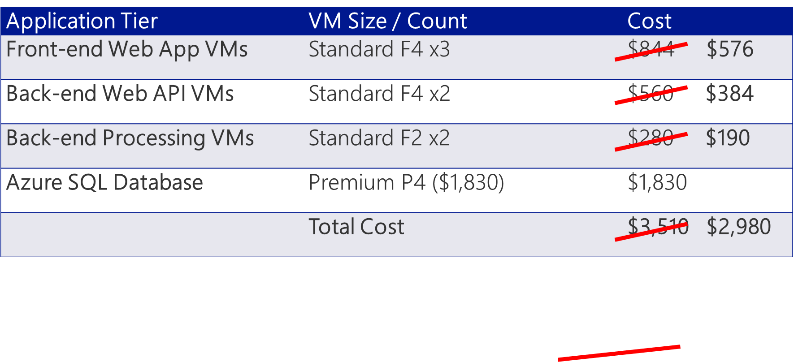
Preferred solution Phase 1 – cost and savings with Reserved Instance
Existing Architecture (Current) Monthly Cost: $6,902
Total Monthly Savings over Existing Architecture: $3,922
Total Annual Savings over Existing Architecture: $40,704 $47,064
Notes:
Pricing for 3-Year Reserved Instances
VM - Standard F4 = $192 /mo.
VM – Standard F2 = $95 /mo.
SQL Database – Premium P4 = $1,830 /mo.

Slide 25
Preferred solution Phase 2 – overview
The Phase 2 Design switches focus to using Azure Platform (PaaS) services as much as possible to further reduce overall spending.
Migrating the Front-end Web App tier to use Azure Web Apps with the Standard S3 App Service Plan.
Migrating the Back-end Web API tier to use Azure Web Apps with the Standard S3 App Service Plan.
Migrating the Back-end Processing tier to use Azure Web Jobs with the Standard S3 App Service Plan.
Implementing Autoscale for all 3 application tiers (Front-end Web App, Back-end Web API, and Back-end Processing).
Implementing Traffic Manager in Performance mode instead of the External Load Balancer.

Slide 26
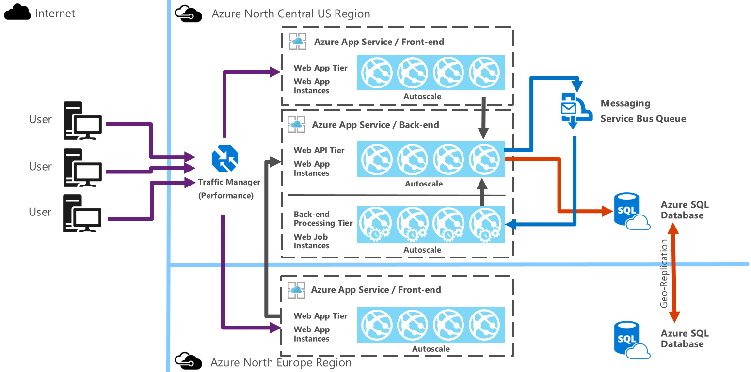
Preferred solution Phase 2 – preferred architecture

Slide 27
Preferred solution Phase 2 – migration steps
It is recommended to modify the architecture for each of the Application Tiers individually to reduce the risk of application downtime during the migration process. Here is a sample outline of recommended steps:
Migrate Front-end Web App tier over to Azure Web Apps with Autoscale.
Determine the appropriate App Service Plan.
Setup the Azure Web App.
Configure Autoscale.
Replace the Internet Load Balancer with Traffic Manager in Geographic mode pointed to the Web App.
Create Traffic Manager.
Set it up with Web App.
Swap out Load Balancer endpoint to use Traffic Manager.
Remove old Internet Load Balancer.

Slide 28
Preferred solution Phase 2 – migration steps (continued)
Migrate Back-end Processing over to Azure Web Jobs with Autoscale.
Determine the appropriate App Service Plan.
Setup the Azure Web Jobs.
Configure Autoscale.
Remove old VM Scale Set.
Migrate Back-end Web API over to Azure Web Apps with Autoscale.
Determine the appropriate App Service Plan.
Setup the Azure Web App.
Configure Autoscale.
Point Front-end Web App and Back-end Processing application tiers to new Azure Web App.
Remove old VM Scale Set and Internal Load Balancer.

Slide 29
Preferred solution Phase 2 – migration steps (continued)
Setup Front-end Web App duplicate in Azure North Europe Region.
Create App Service Plan in Azure North Europe Region.
Setup the Azure Web App.
Configure Autoscale.
Add new region to Traffic Manager.

Slide 30
Preferred solution Phase 2 – cost and savings
Application Tier | VM Size / Count | Cost
Front-end Web App | Standard S3 ($292) x3 | $876
Back-end Web API | Standard S3 ($292) x2 | $584
Back-end Processing | Standard S3 ($292) x1 | $292
Azure SQL Database | Premium P4 ($1,830) | $1,830
 | Total Cost | $3,582
Existing Architecture (Current) Monthly Cost: $6,902
Total Monthly Savings over Existing Architecture: $3,320
Total Annual Savings over Existing Architecture: $39,840
Notes:
Pricing:
App Service Plan - Standard S3 = $292 /mo.
SQL Database – Premium P4 - $1,860 /mo.

Slide 31
Preferred objections handling
Objection
Reducing the overall spending on Azure is great, but how will we ensure costs remain optimized?
Potential answer
The use of automation through Azure services like Autoscale will allow the specific pricing tiers and instance counts to be controlled in a manner that is immune to the user errors of manual processes. Every time a VM instance is scaled out/in, it will be completed the exact same way every time. Once the optimized pricing tiers and scaling configurations are set, they will remain that way until deliberately changes.
Additionally, third-party tools like Cloud Cruiser and Hanu Insights can be used to monitor and forecast Azure spending over time.

Slide 32
Preferred objections handling
Objection
If we drastically change the overall architecture, will we be able to migrate it without taking it down for a week?
Potential answer
Overall downtime can be minimized drastically with careful planning and a step-by-step phased approach to the migration. The basic idea is to migrate a single component of the workload at a time to minimize the risk of bringing down other components.

Slide 33
Preferred objections handling
Objection
Our operations team is new to the cloud and Microsoft Azure. While we are comfortable using the IaaS services, we are concerned that PaaS services will be difficult to monitor and maintain when mixed with IaaS services in our overall environment.
Potential answer
There are certainly things an operations team needs to learn when adopting a technology they are not very familiar with. Fortunately, with the Azure PaaS services, such as Azure App Service, there will be a decrease in the amount of time and work necessary to maintain the application workload running in Azure. It will give the operations team more time to spend on other tasks.

Slide 34
Preferred objections handling
Objection
We are concerned that the system performance for the European users will not be as good as it needs to be. In the past we have had employees work while traveling and the system was slow for them.
Potential answer
Implementing Traffic Manager in Geographic mode with a separate Web App instance located in the North Europe Azure Region allocates dedicated resources to handle load from the European users. It also puts the application endpoint geographically closer to them which reduces network latency across the internet and will speed up load times.

Slide 35
Preferred objections handling
Objection
The VM sizes currently used appear to be more than we need, but how can we determine what the appropriate sizes should be?
Potential answer
Determining the appropriate VM sizes can be accomplished by comparing the current utilization percentages of the VMs in the Existing Architecture to the different VM size pricing tiers. This metric can be used to determine VM sizes for the different application tiers that more closely align with real workload demand.

Slide 36
Preferred objections handling
Objection
We have already purchased SQL Server and other product licenses. I am worried the savings from optimizing spending using Azure PaaS services will not be significant to be worth it.
Potential answer
The reduces monthly spending on Azure services and the reduced workload on IT Operations staff is not just a one-time savings. It is a monthly savings that will be realized over the coming months, and even years. In addition to these compounded savings, the use of Azure PaaS services also completely eliminates the need to purchase any future SQL Server upgrades.

Slide 37
Customer quote
“We have realized some savings when we initially adopted Microsoft Azure, but with these proposed changes we are not only staying innovative; we are setting ourselves up to remain competitive on a technology level for years to come.”
—Jay Calvin, Chief Executive Officer, Contoso Financial Inc.

